Slide 1

Let’s start with Allah Yaar
Bs in Computer Science

Slide 2
Lab Activity 1: Introduction to Microsoft PowerPoint
Objective: Familiarize students with PowerPoint, including its purpose and main features.
Tasks
Open Microsoft PowerPoint and explore the interface: Ribbon, toolbar, slide pane, and notes section.
Discuss practical applications of PowerPoint for presentations in various fields.
Show how to start a new presentation or open an existing one.

Slide 3
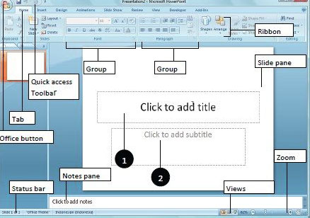
Lab Activity 1: Introduction to Microsoft PowerPoint

Slide 4
Creating a New Presentation
Objective: Guide students on creating a new presentation from scratch.
Tasks
Open a blank presentation and understand slide layouts (title slides, content slides, etc.).
Demonstrate choosing templates or themes to customize appearance.
Save the presentation with an appropriate file name.

Slide 5
Adding New Slides
Objective: Teach students how to add and manage slides in their presentation.
Tasks
Insert new slides and select different layouts as needed.
Reorder slides by dragging and dropping in the slide pane.
Practice duplicating and deleting slides to understand editing options.

Slide 6
Formatting Text
Objective: Explore text formatting tools in PowerPoint.
Tasks
Add text to slides, format fonts (size, color, style), and experiment with bullet points and numbered lists.
Add text to slides, format fonts (size, color, style), and experiment with bullet points and numbered lists.
Introduce the importance of readability in presentations and discuss best practices for font choice and size.

Slide 7
Adding Multimedia Elements (Images, Charts, Shapes, Icons)
Objective: Show students how to enhance presentations with multimedia elements.
Tasks
insert images from files and online sources, and apply simple edits like cropping and resizing.
Add and format charts to display data visually, covering basic chart types (bar, line, pie, etc.).
Use shapes, icons, and SmartArt to make content more engaging and visually organized.
Emphasize the value of visual elements in reinforcing key points.

